Slide 1
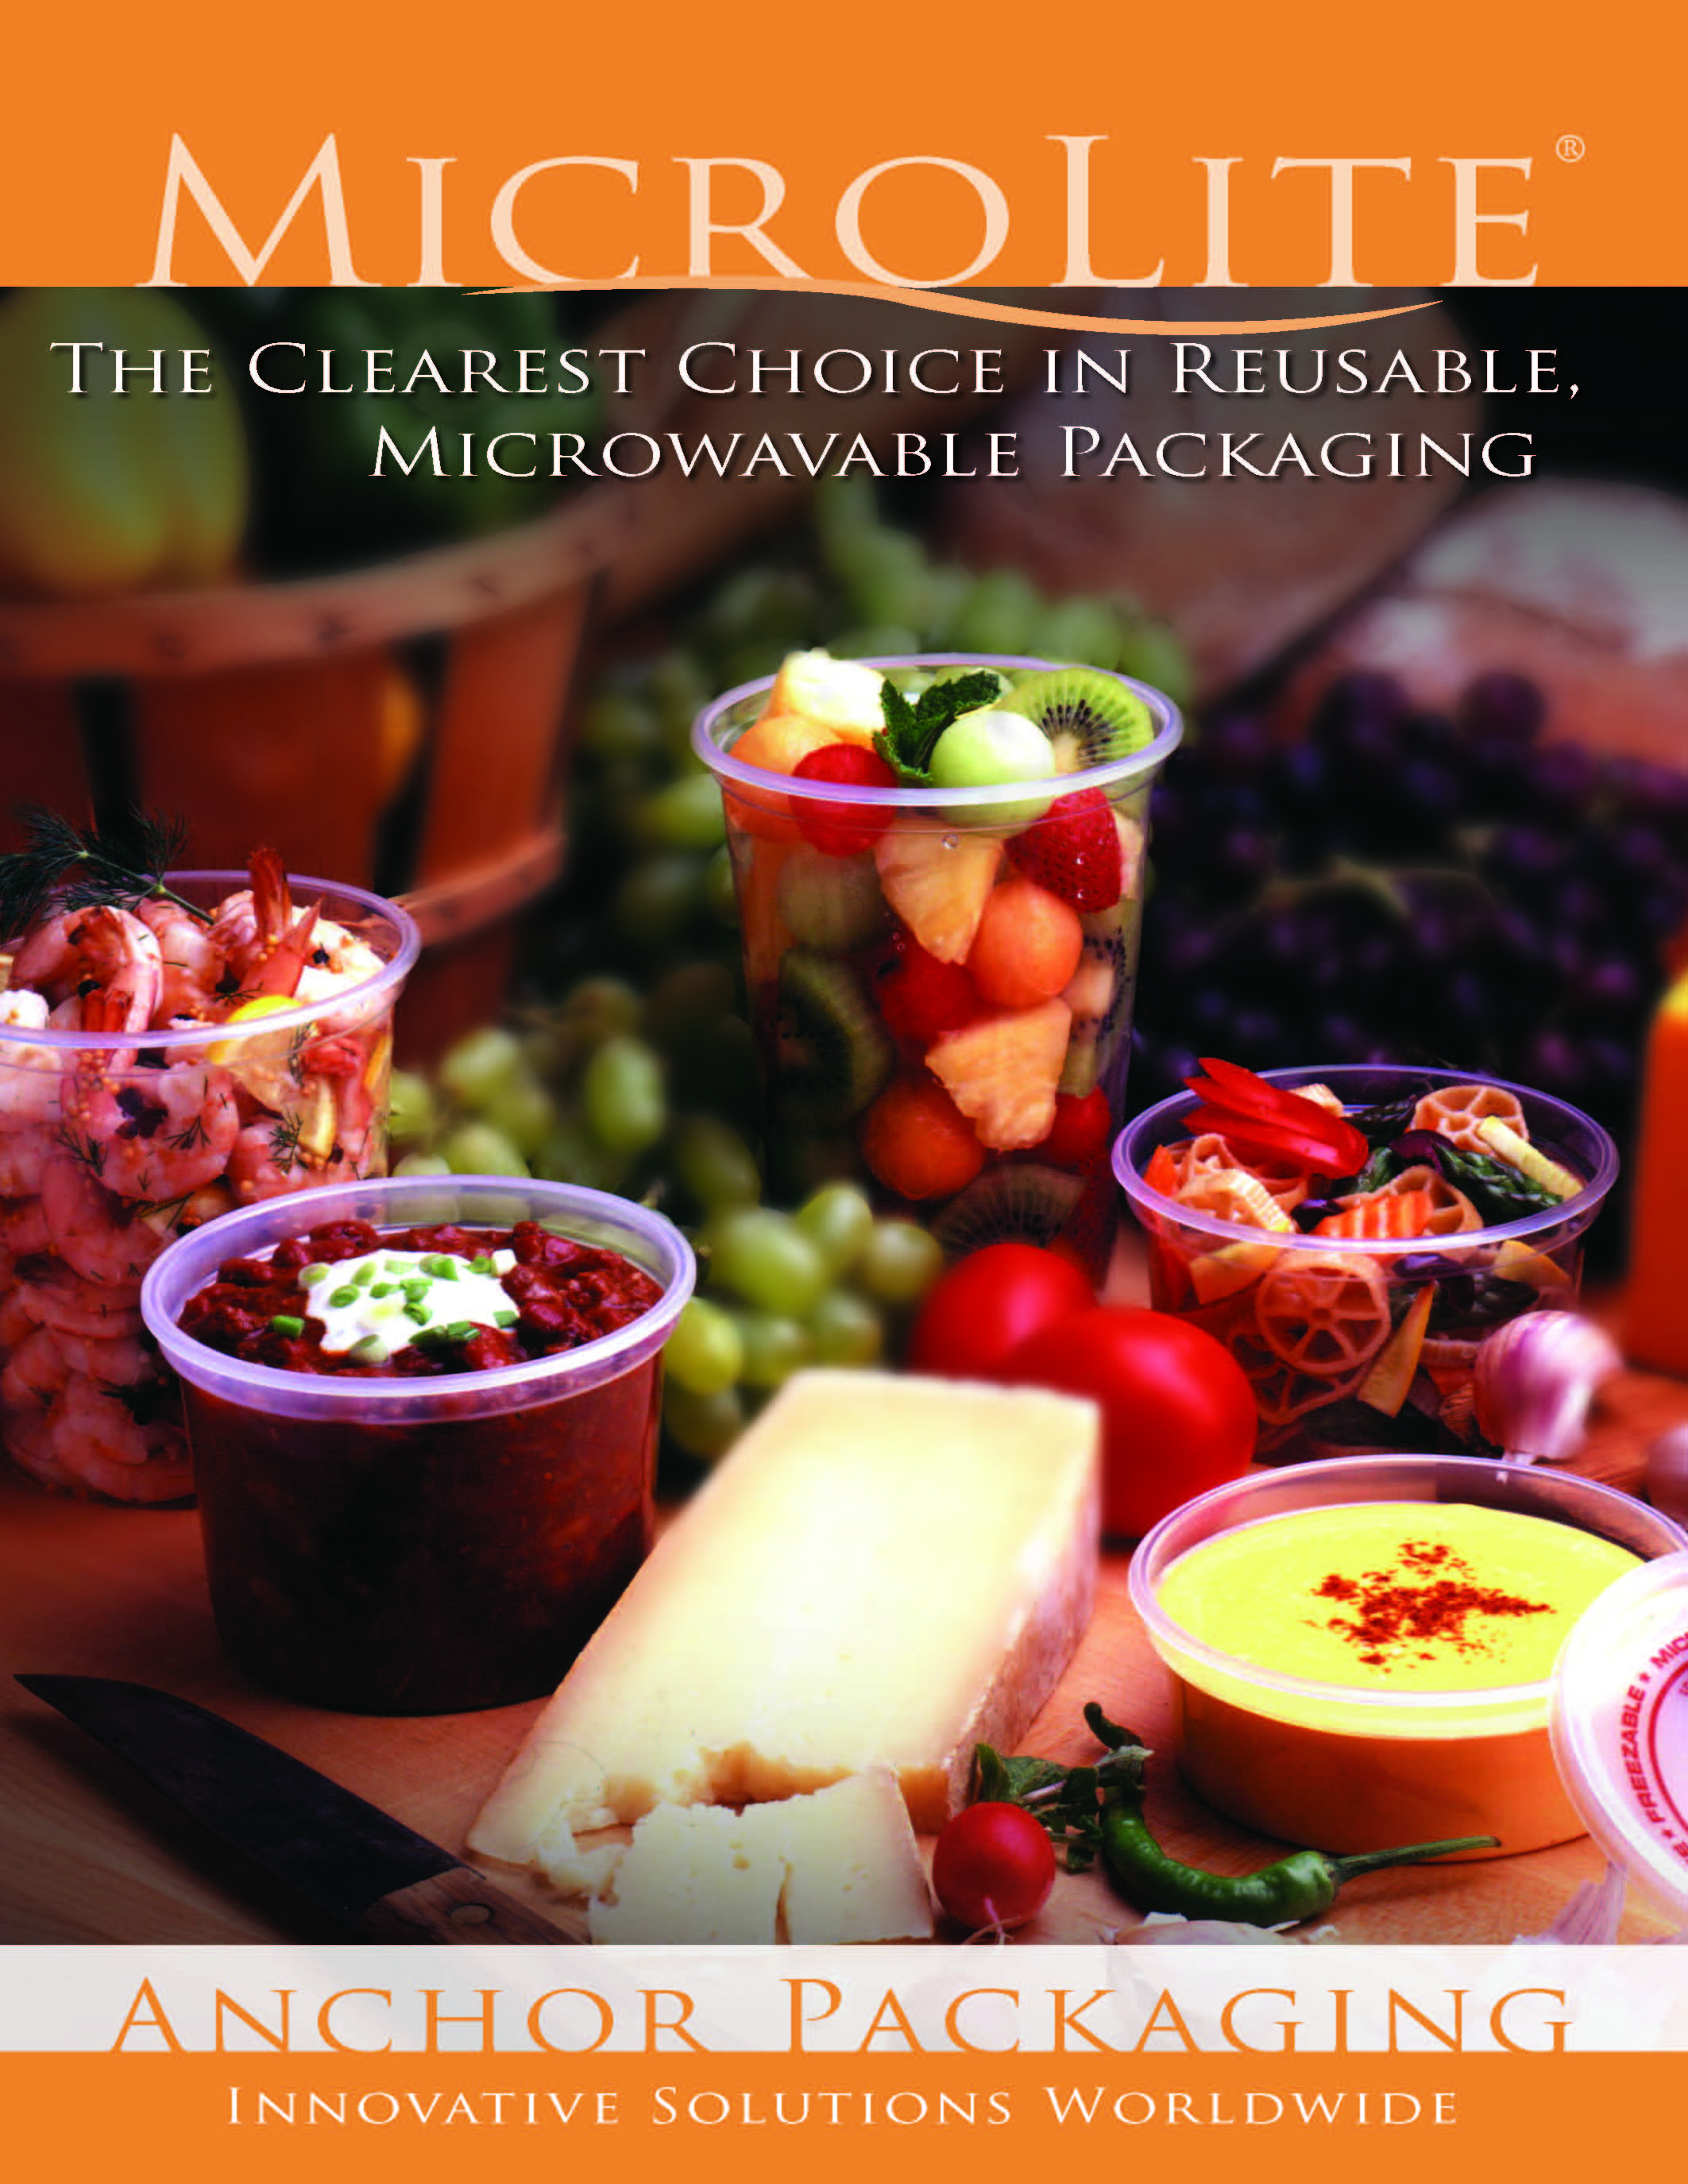

Slide 2
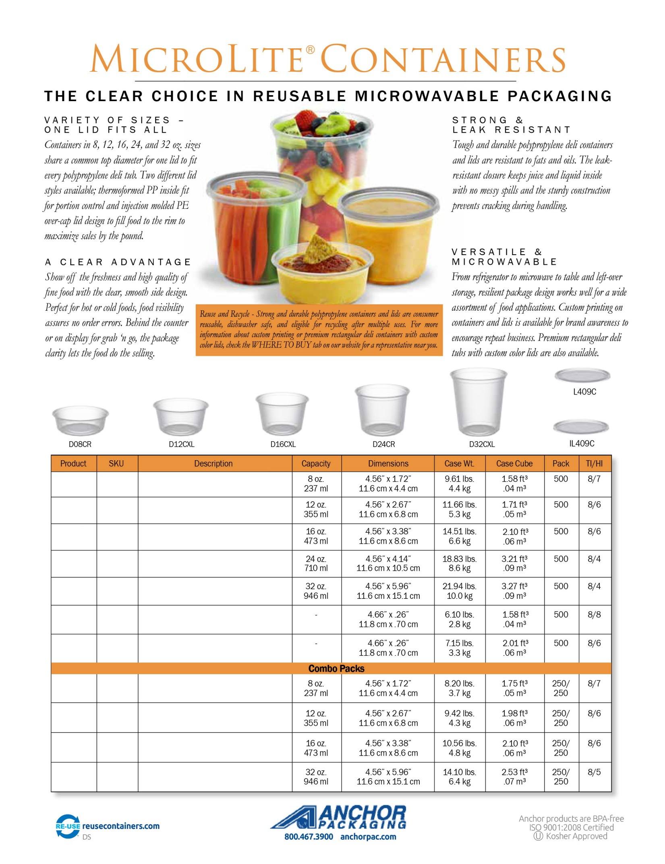
D08PS
75002440
Prime Source 8 oz Clear PP Deli Cup

