Slide 1
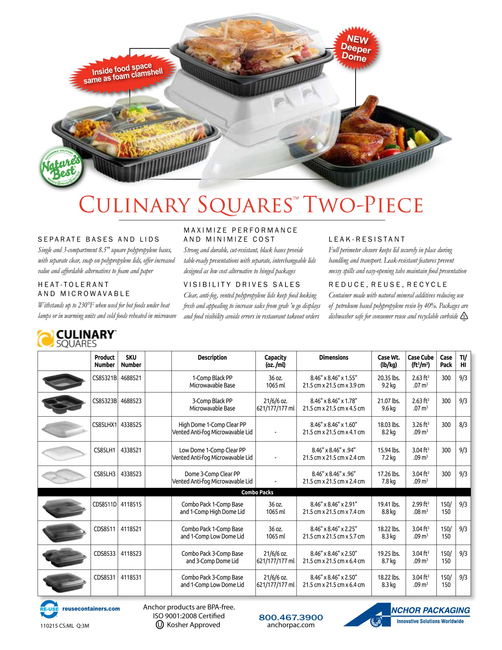
Insert LOGO or
type contact information here
Your
SKU
Number
here
Number
here
Number
here
Number
here
Number
here
Number
here
Number
here
Number
here
Number
here

