Slide 1
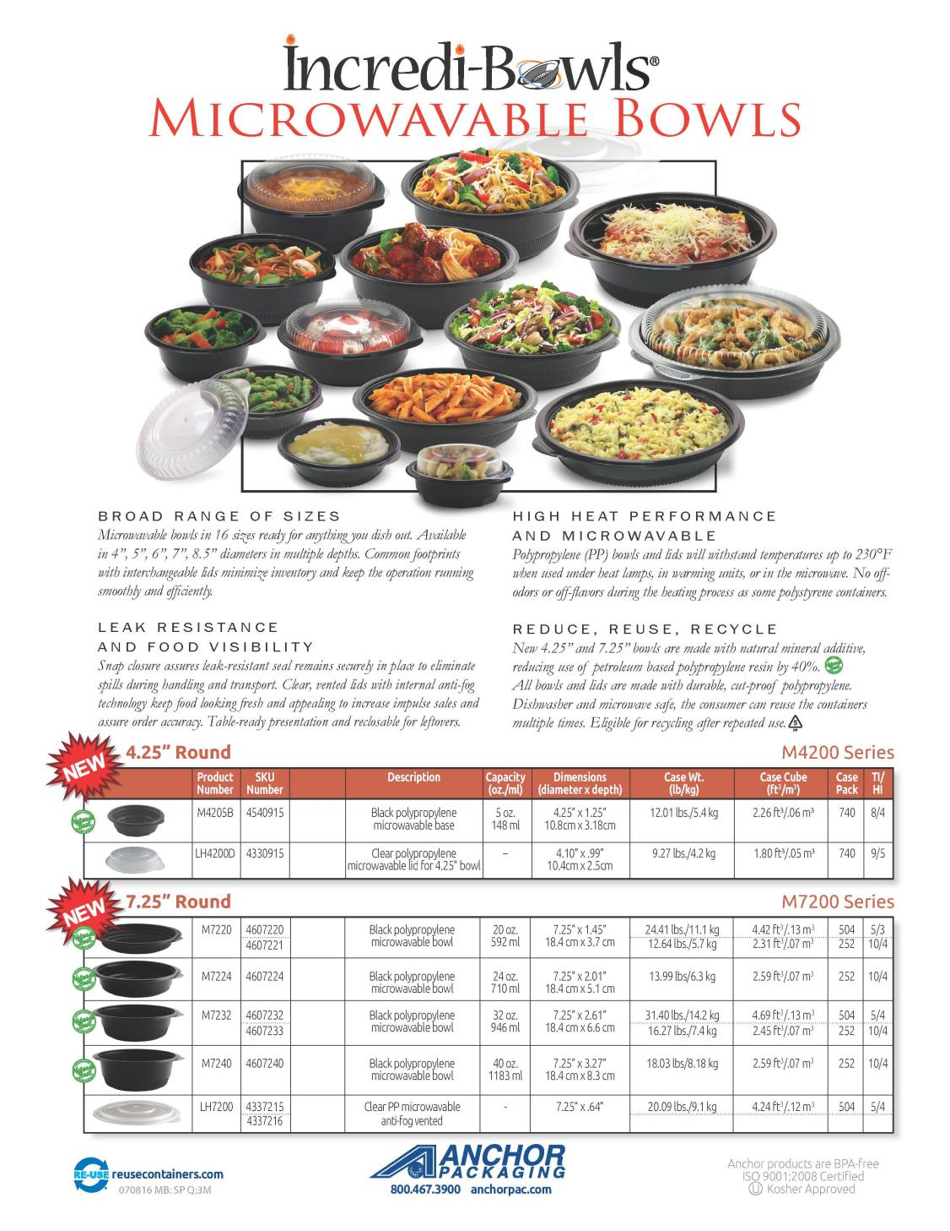
SKU
Number
Here
Number
here
Number
Here
Number
here
Number
Here
Number
here
Number
Here

Slide 2
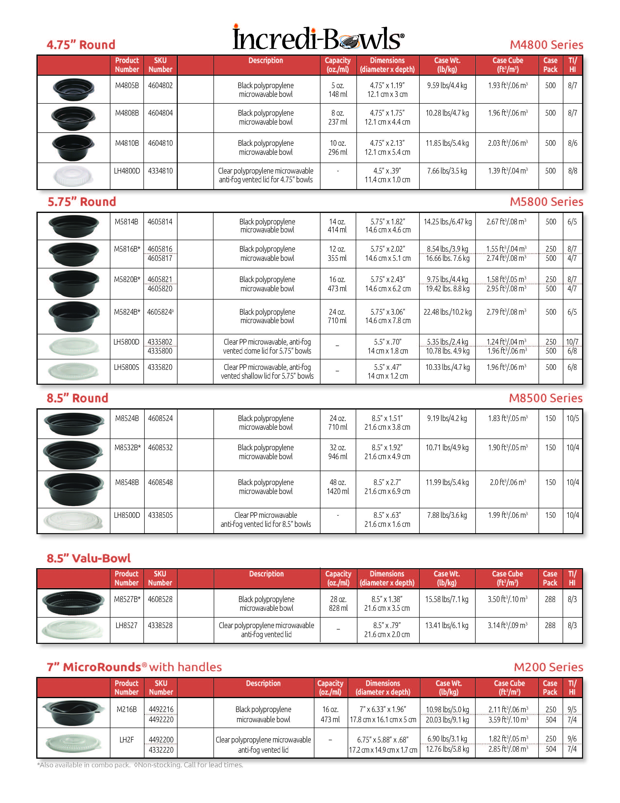
SKU
Number
Here
Number
Here
Number
Here
Number
here
Number
Here
Number
here
Number
Here
Number
here
Number
Here
Number
Here
Number
Here
Number
here
Number
Here
Number
here
SKU
Number
Here
Number
Here
SKU
Number
Here
Number
Here

Slide 3
SKU
Number
Here
Number
here
Number
Here
Number
Here
Number
Here
Number
Here
Number
here
Number
Here
Number
Here
Number
Here
Number
Here

