Slide 2
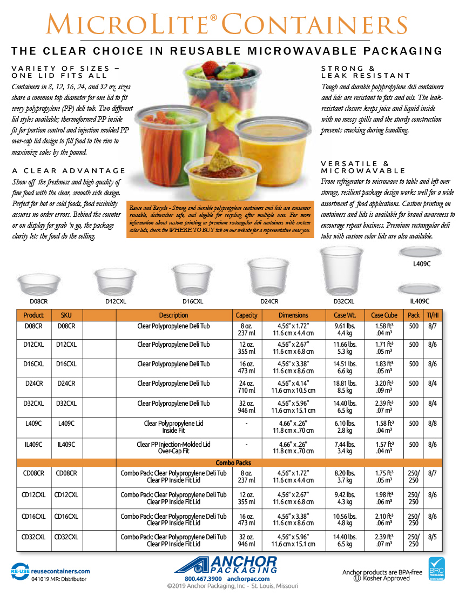
Number
here
Number
here
Number
here
Number
here
Number
here
Number
here
Number
here
Number
here
Number
here
Number
here
Number
here

